Slide 1
Factors Affecting Covid-19 Vaccination Rates in the US:
A Data Analysis
Group 9
Team Members: Ricardo Herrera, Eugene Witherspoon, Feipeng Yang, Jenny(Yijuan) Yang

Slide 2
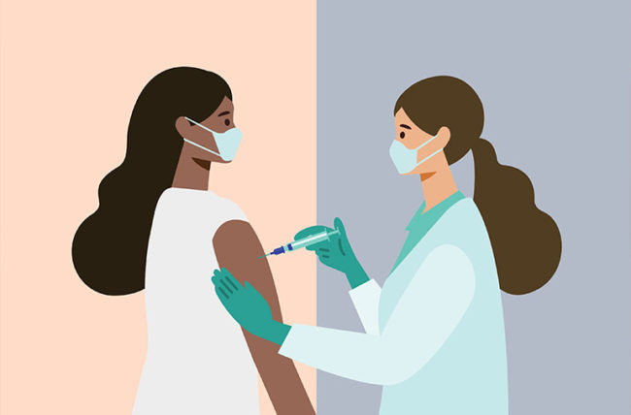
Why Look at Covid-19 Vaccination Rates?
Although COVID-19 vaccination may be a controversial topic, it remains a public health priority among many health entities at the federal, state and and local level.
Finding trends would allow health authorities to better target underserved populations
Challenging presupposed ideas about which groups are more likely to be vaccinated is interesting
Our analysis will explore whether vaccination rates vary significantly within several different populations including those with varying levels of socio economic status, education and political party affiliation.
Notes:
More importantly for public health entities, finding correlations between populations and vaccination rates allows these entities to target certain groups being underserved by current health authorities and could allow them to tailor public health initiatives in certain areas based on what is found in the data
about what may be affecting vaccination rates and to what degree is interesting and worthwhile taking a deeper look
The data was readily available for COVID-Vaccination rates and was also relatively up to date kaggle provided some interesting socioeconomic data at the county level that we could use to compare against these vaccination rates.

Slide 3


Data Exploration and Cleanup
Data Sources:
Vaccination Complete Percentage by County:
Data.CDC.gov- Selected Sept 30th, 2021 accumulated data
2) US Socio Health Data by County:
Kaggle- 180 columns covering aspects including Socio Health/Economics/Education etc
3) US 2020 Presidential Election Voting by County:
Kaggle- Political party Dem/Rep represented by president candidates
4) US Social Vulnerability Index (SVI) by County:
Kaggle- Selected columns from original dataset: Vaccine Hesitancy for COVID-19
5) US County Coordinates:
Kaggle- with FIPS/Lat/Long
Notes:
Jenny

Slide 4
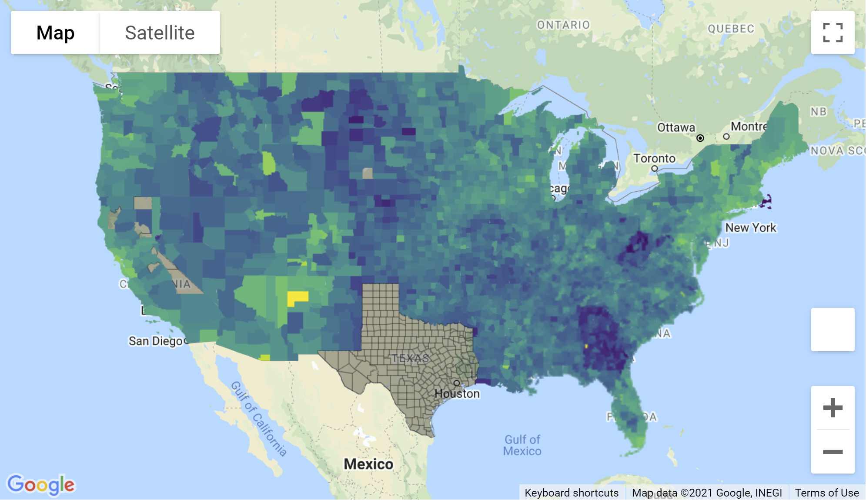
Data Exploration and Cleanup
Data Cleanup:
Merge Vaccination Percentage with each individual datasets by FIPS.
Rename/Rearrange selected columns
Drop na and delete 0 value lines (monitor dataframe shape)
Save output in separate folder
Visualize data to check
Texas only provides data that are aggregated at the
state level.
When asked about the lack of data, Douglas Loveday, a
press officer with the Texas Department of State Health
Services (DSHS), said, “State statute prevents us from
sharing person-level immunization data.”

Slide 5
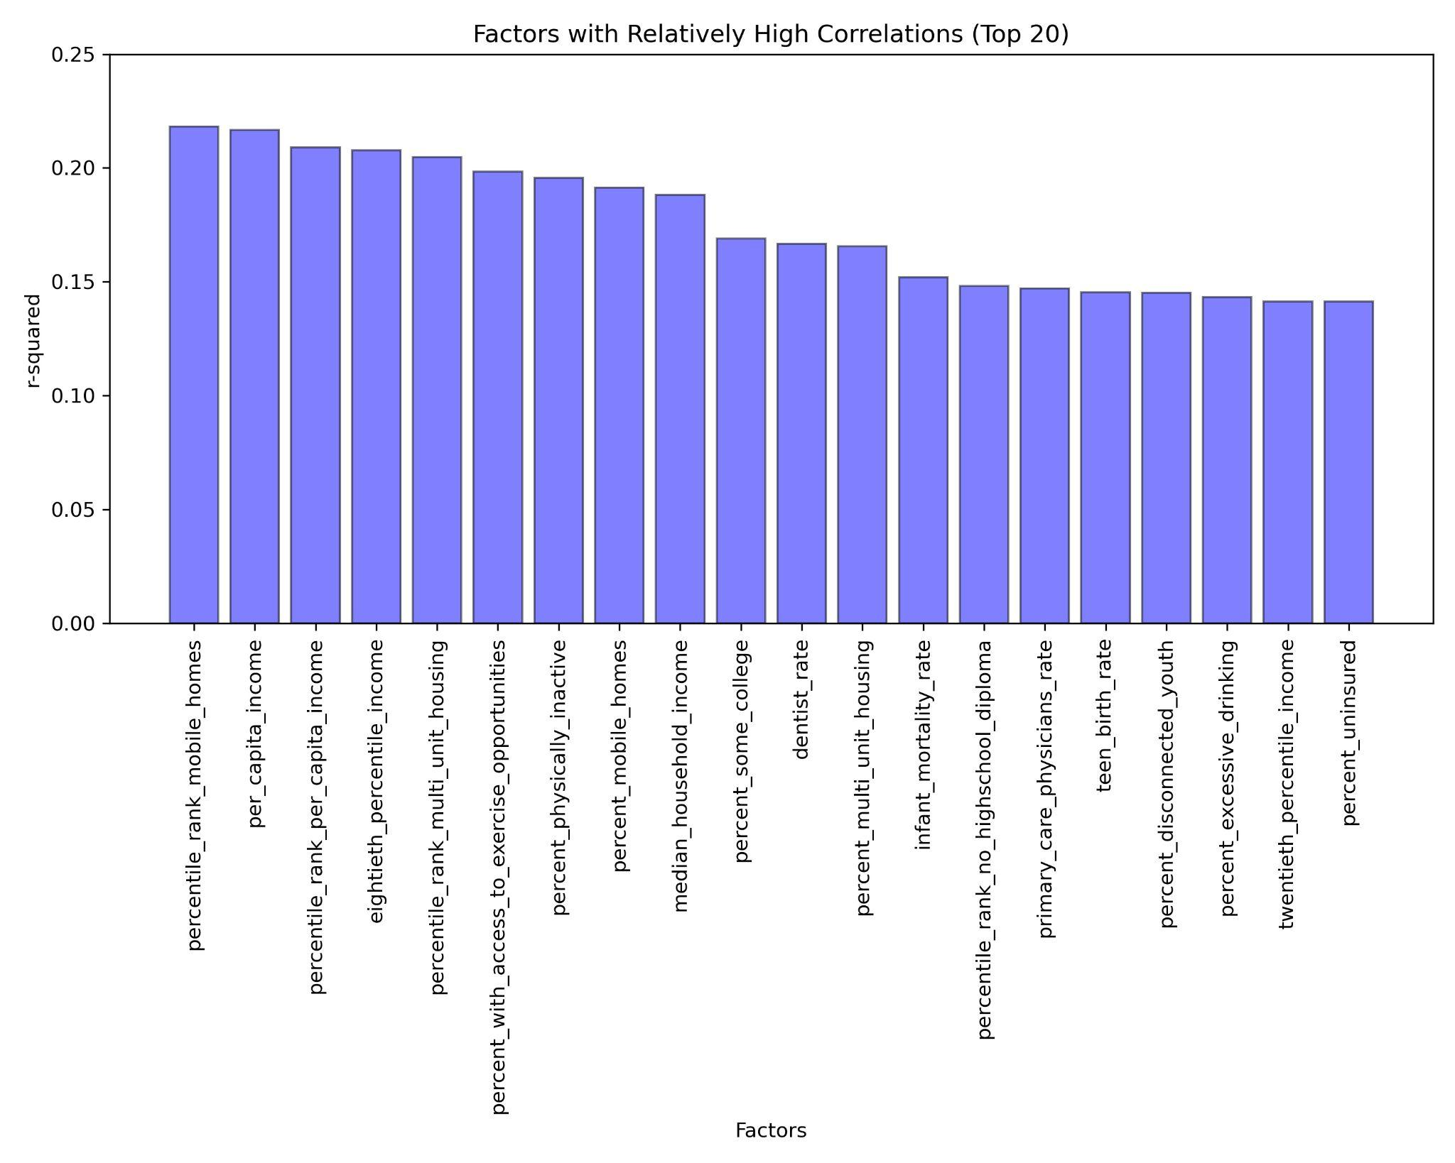
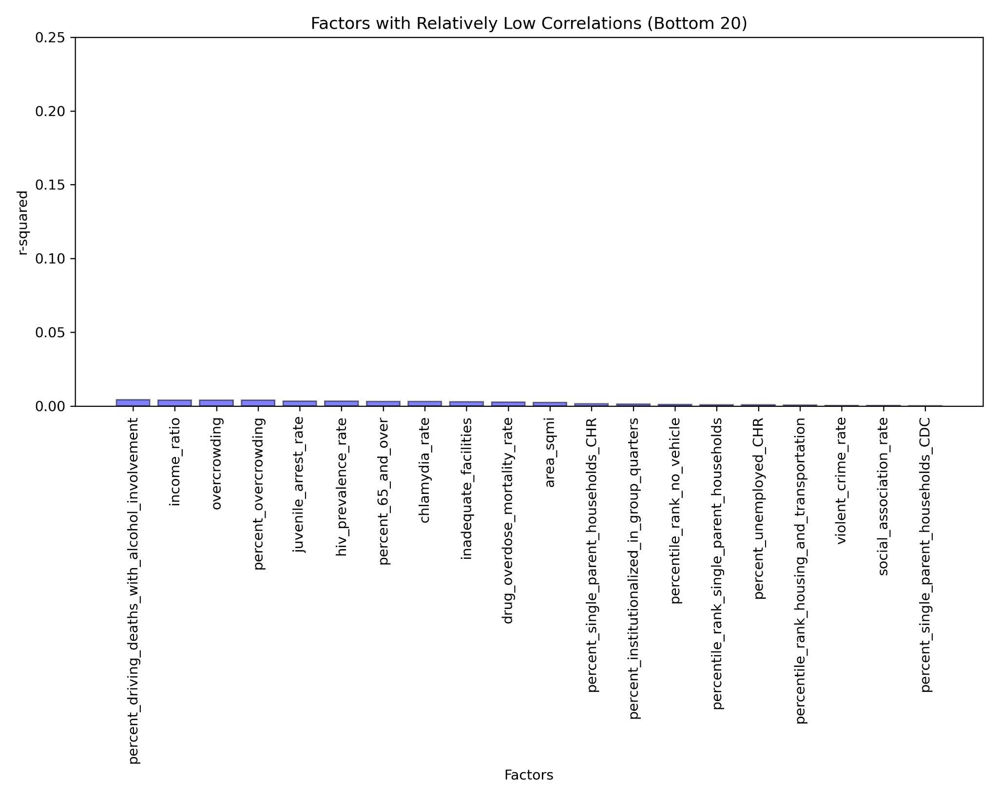
Overview Analysis of Correlation for Potential Factors
Correlations between 175 socio economy/health/education etc relationed factors vs. vaccination rate. Low correlation with single factors resulted in a direction shift of the project.

Slide 6
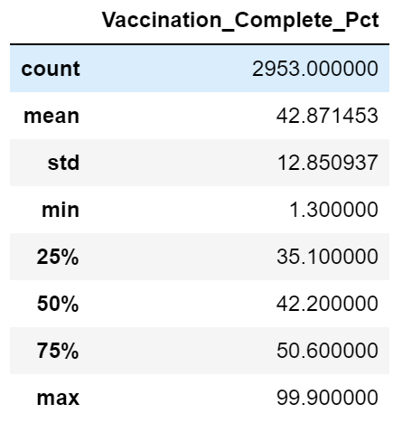
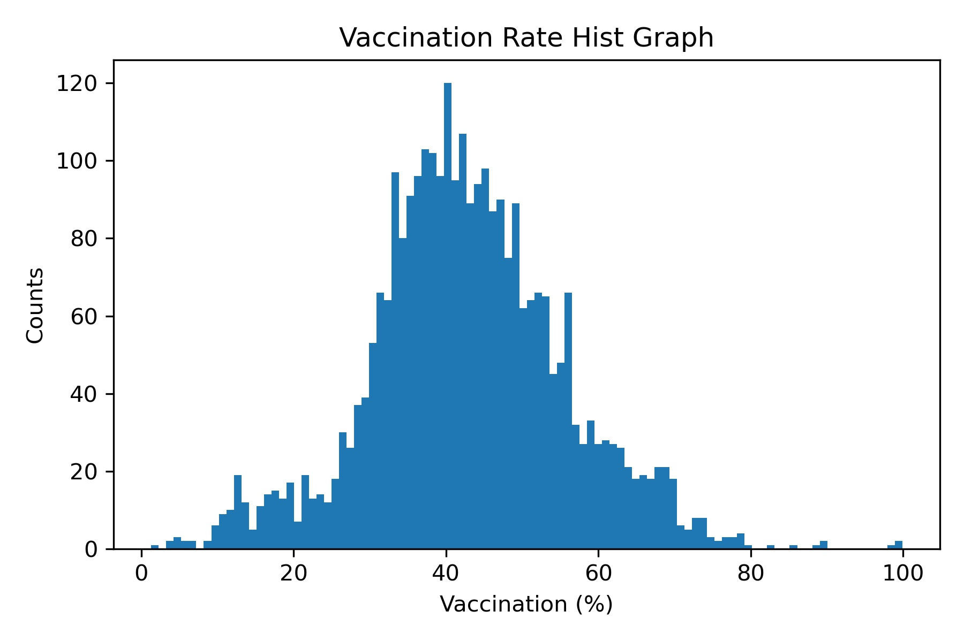
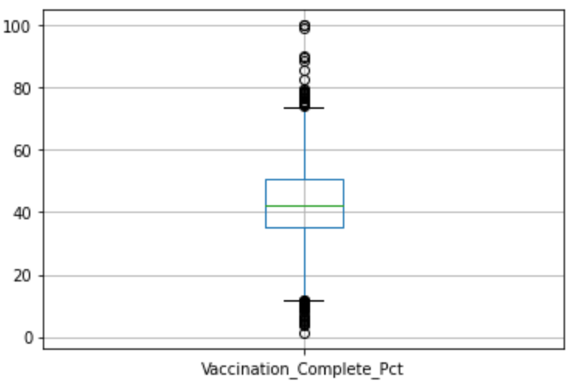
Factor: Vaccination Rate by County Overview
Vaccination Rate Observation:
2953 counties not including TX and a few other areas
Mean close to Mode indicating symmetrical data
Values below 11.85 and above 73.85 could be outliers
Not normally distributed
US Vaccination Rates by County
NormaltestResult(statistic=38.85704667200041, p-value=3.6500559671631735e-09)

Slide 7
Factor: Vaccination Rate and Social Vulnerability Index
CDC SVI (Social Vulnerability Index) uses U.S. Census data to determine the social vulnerability of every census tract.
SVI ranks the tracts on 15 social factors and further groups them into four related themes.
Socioeconomic Status
Below Poverty
Unemployed
Income
No High School Diploma
Household Composition & Disability
Aged 65 or Older
Aged 17 or Younger
Civilian with a Disability
Single-Parent Households
Minority Status & Language
Minority
Aged 5 or Older who Speaks English “Less than Well”
Housing Type & Transportation
Multi-Unit Structures
Mobile Homes
Crowding
No Vehicle
Group Quarters

Slide 8
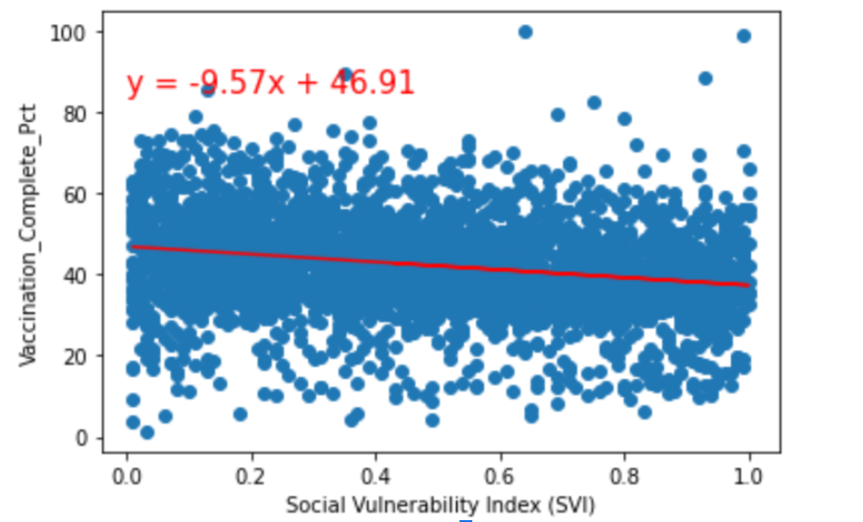
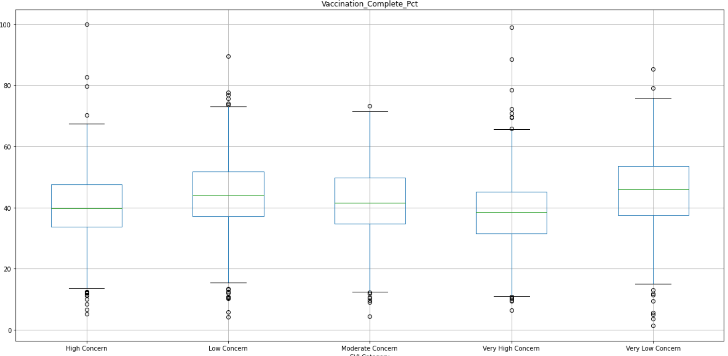
Factor: Vaccination Rate and Social Vulnerability Index
The Linear Regression suggested a low negative correlation between SVI and Vaccination Rates
Anova Test: Null hypothesis- Vaccination rates from counties with different SVI level of concerns have the same means.
The statement is rejected with pvaue <0.05, indicating statistically significant difference among groups by SVI categories.
F_onewayResult (statistic=37.689671465273356, pvalue=9.114046064617615e-31)
SVI vs. Vaccination Rates
The r value is: -0.22290867716012341
The r-squared is: 0.049688278353276126

Slide 9
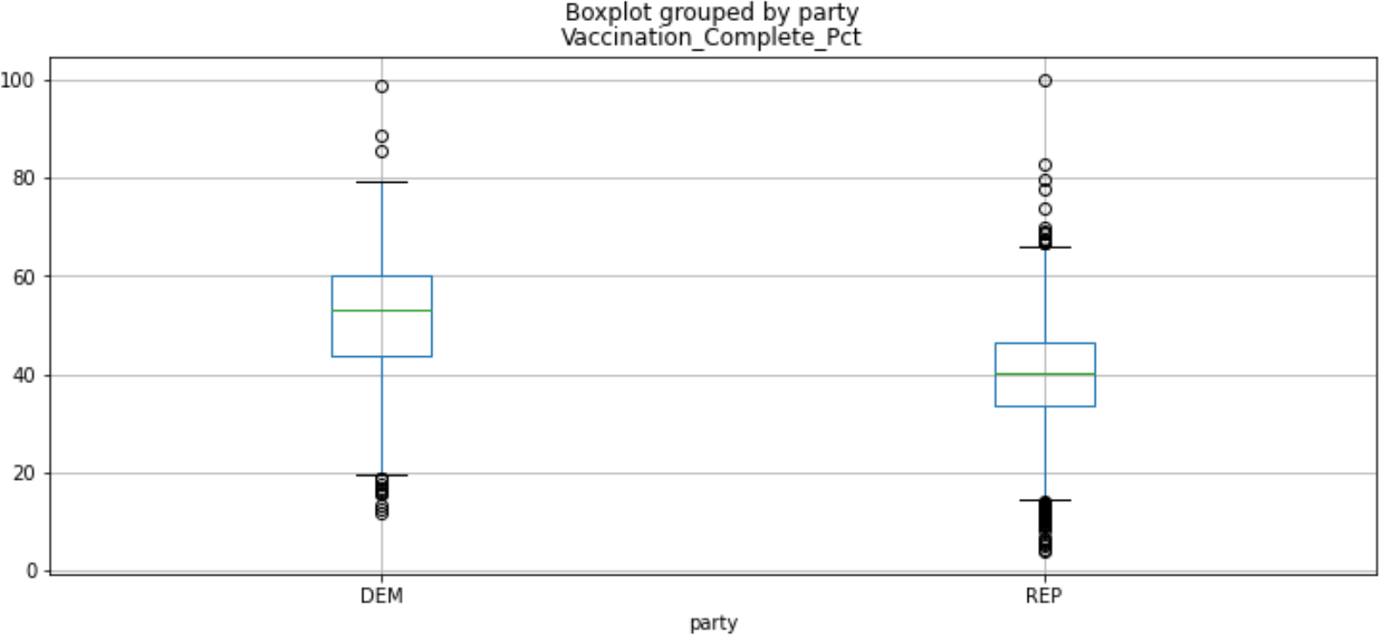
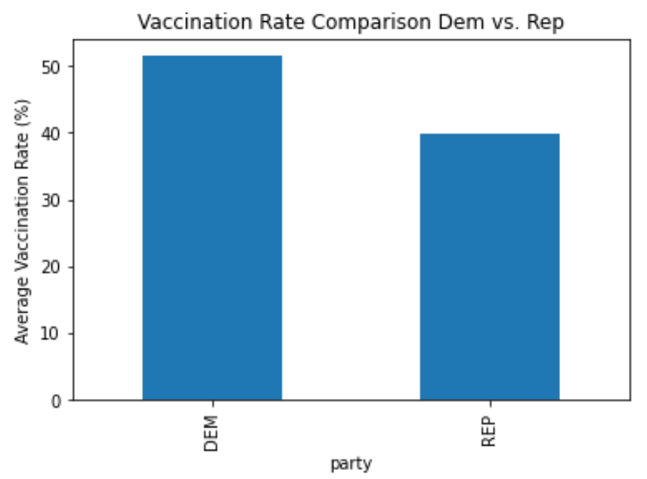
Factor: Vaccination Rate and Political Party
The average vaccination rate in counties who voted for Democratic Party is higher than counties voted for Republican Party by +10%
Anova Test: Null hypothesis- Vaccination rates from counties voted for different parties have the same means.
The statement is rejected with pvaue <0.05, indicating statistically significant difference among groups by parties.
F_onewayResult(statistic=419.80373600969176, pvalue=5.332110840012159e-87)

Slide 10
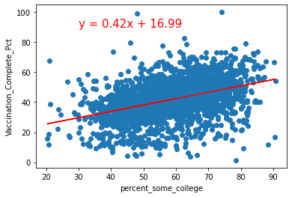
Factor: Vaccination Rate and College Education
Anova Test: The statement is rejected with pvalue <0.05, indicating statistically significant difference among groups by Some College Education .
F_onewayResult(statistic=120.63668534496654, pvalue=4.422200453915255e-73)
Rejecting null hypothesis
Weak Positive correlation
The r value is: 0.406371543459051
The r-squared is: 0.16513783133329193

Slide 11
Factor: Vaccination Rate and Income level
The County Health Rankings & Roadmaps uses National Center for Health Statistics among others to collect county level data and is collected by the University of Wisconsin Population Health Institute
Income levels at the county level were collected in 2019 for each county in the U.S.
Income is often linked to other outcomes such as quality of life and often tied to measure of health.
Median income - is a measure of the household income where half earn more and half earn less and less likely to be skewed by outliers in any given county (i.e. Elon Musk lives next door) and is a measure of central tendency.
Per capita income - is an average of income in an area spread among all residents of a household (including children). This can be paint a more realistic picture when comparing households who have household income spread over many people (typically larger families) to high earning individual income earners (e.g. DINK).
Notes:
Income provides economic resources that shape choices about housing, education, child care, food, medical care, and more. Wealth, the accumulation of savings and assets, helps cushion and protect us in times of economic distress. As income and wealth increase or decrease, so does health.

Slide 12
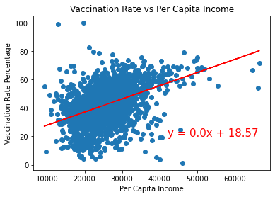
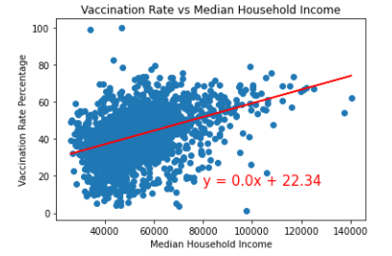
Factor: Vaccination Rate and Income level (Per Capita and Median Household)
Linear Regression analysis results with low r value indicating a weak but noticeable positive correlation of higher vaccination rates in US counties with higher per capita and median income levels. ANOVA test added for more insight.
The r value is: 0.40747374897221234
The r-squared is: 0.1660348561014695
The r value is: 0.44152054535942087
The r-squared is: 0.19494039197448043

Slide 13
Factor: Vaccination Rate and Income level (Per Capita and Median Household)
ANOVA Test:
Alternate Hypothesis: There are significant differences in the mean of vaccination rates between households of varying levels of income.
Null Hypothesis- There are no significant differences in the mean of vaccination rates between varying levels of income.
Analysis: For one ANOVA test the county data for median house household income was separated into six groups, beginning at up to $40,000 annually, and in $20K increments until $140K/year. Since the p-value from the test was much smaller than 0.05, we rejected the null hypothesis, indicating significant differences in the vaccination rates between populations of varying income. Per capita income showed similar results, using six groups starting at upto $10K/year and increasing by $10K increments up to $60K/year.
Median Income ANOVA result:
Per Capita Income ANOVA result:

Slide 14
Factors: Percent Uninsured and Percent Fair or Poor Health
Percent uninsured:
Percentages of persons who lacked health insurance coverage.
Percent fair or poor health:
Based on a response of fair or poor to the question “Would you say your health in general is excellent, very good, good, fair or poor?”

Slide 15
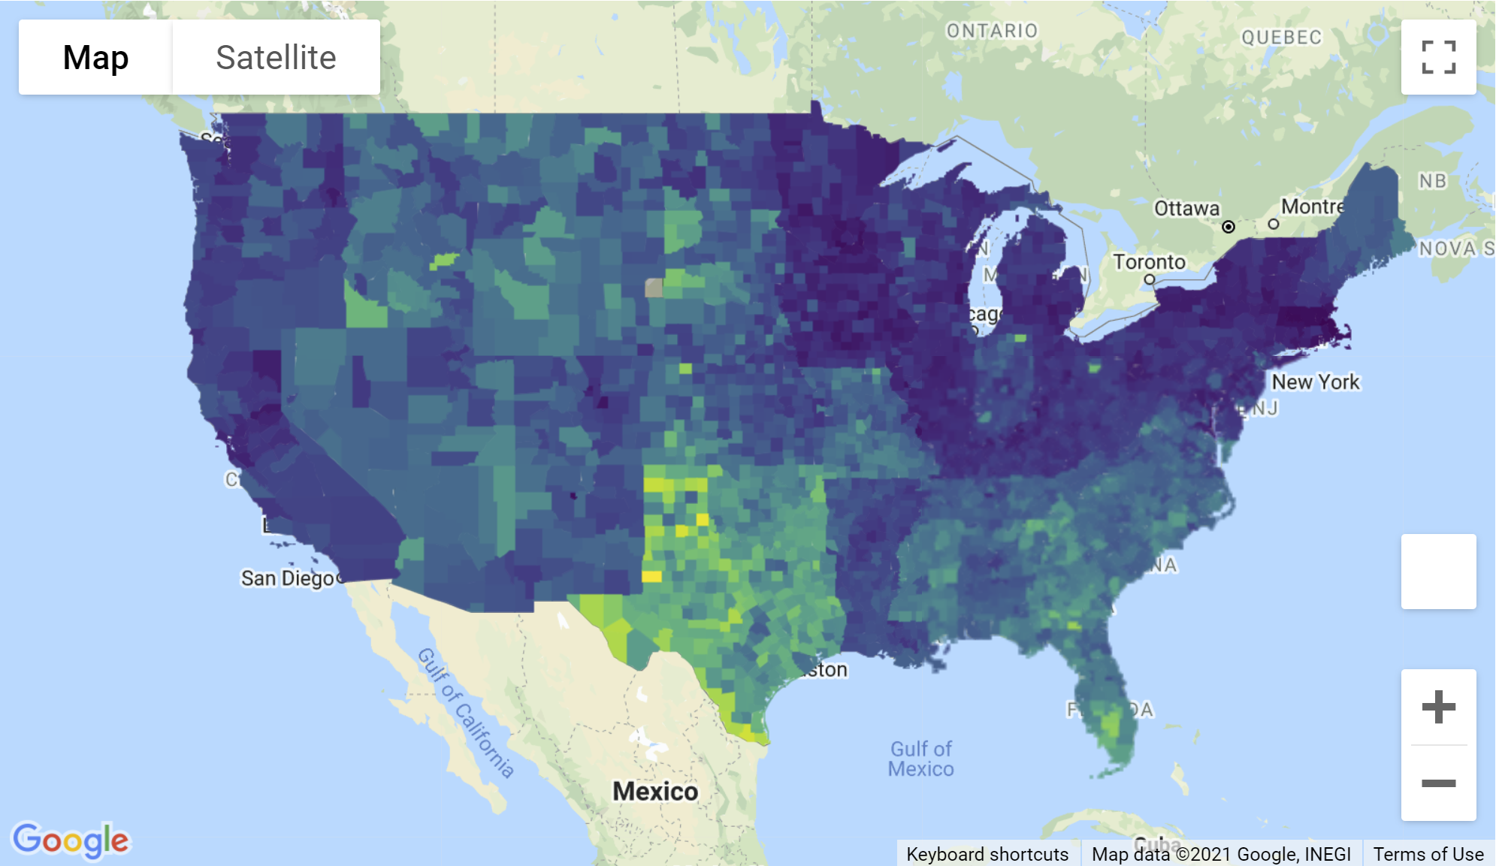
Factor: Vaccination Rate and Percent Uninsured
Vaccination Rate by County in the US
Percent Uninsured by County in the US

Slide 16
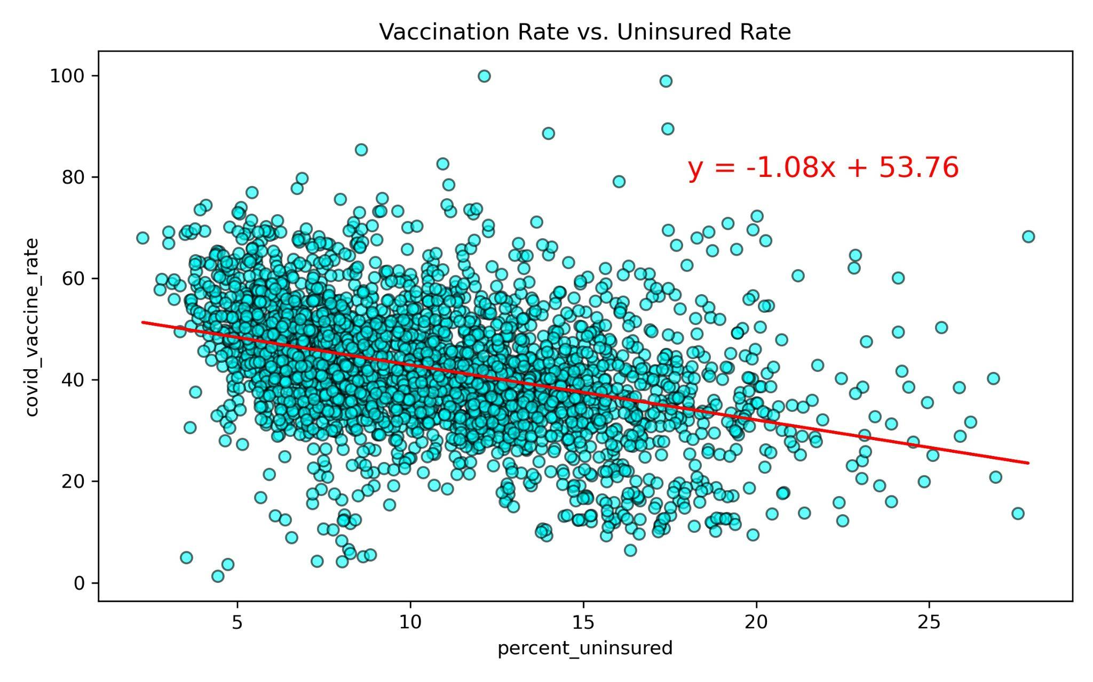
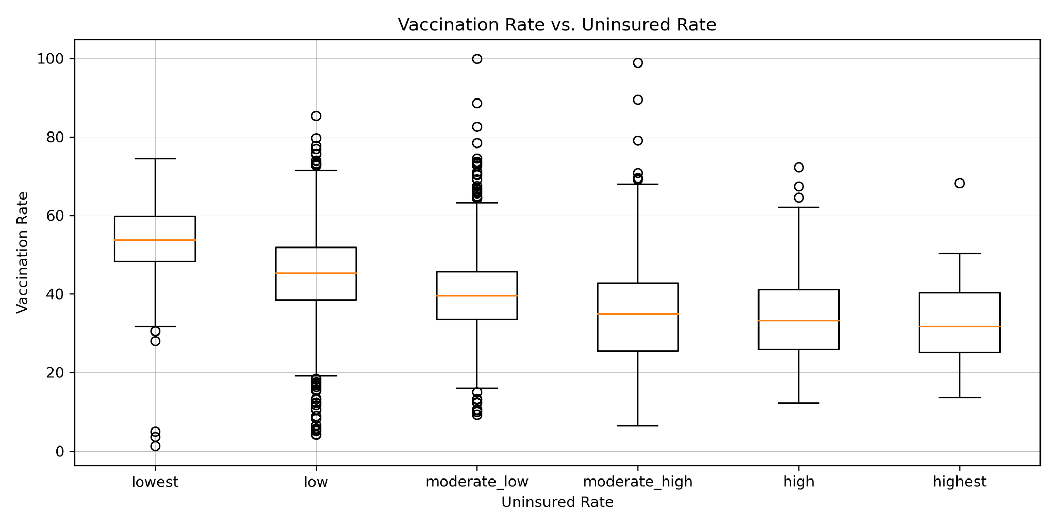
Factor: Vaccination Rate and Percent Uninsured
The Linear Regression suggested a low negative correlation between SVI and Vaccination Rates
ANOVA Test: Null hypothesis- Vaccination rates from counties with different uninsured rate levels have the same means.
The statement is rejected with p-value <0.05, indicating statistically significant difference among groups by uninsured rate categories.
The R-squared is: 0.141
F_onewayResult (statistic=84.5, p-value=4.8 * 10⁻⁸³)

Slide 17
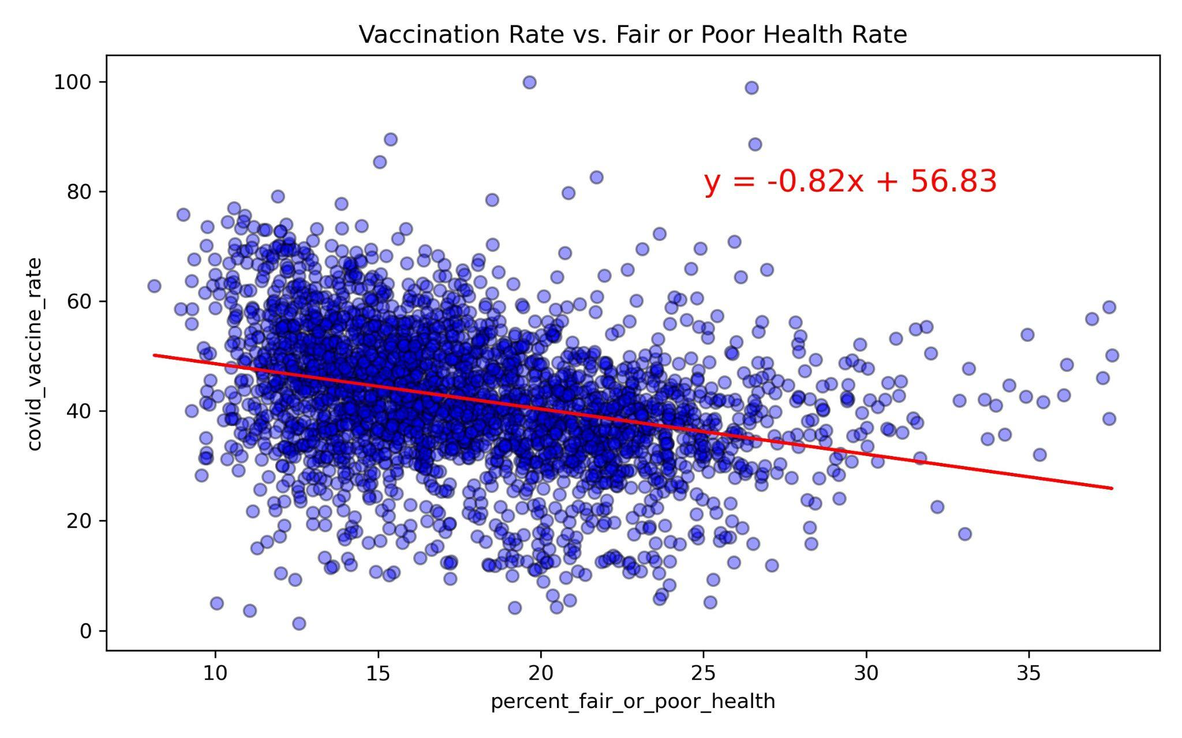
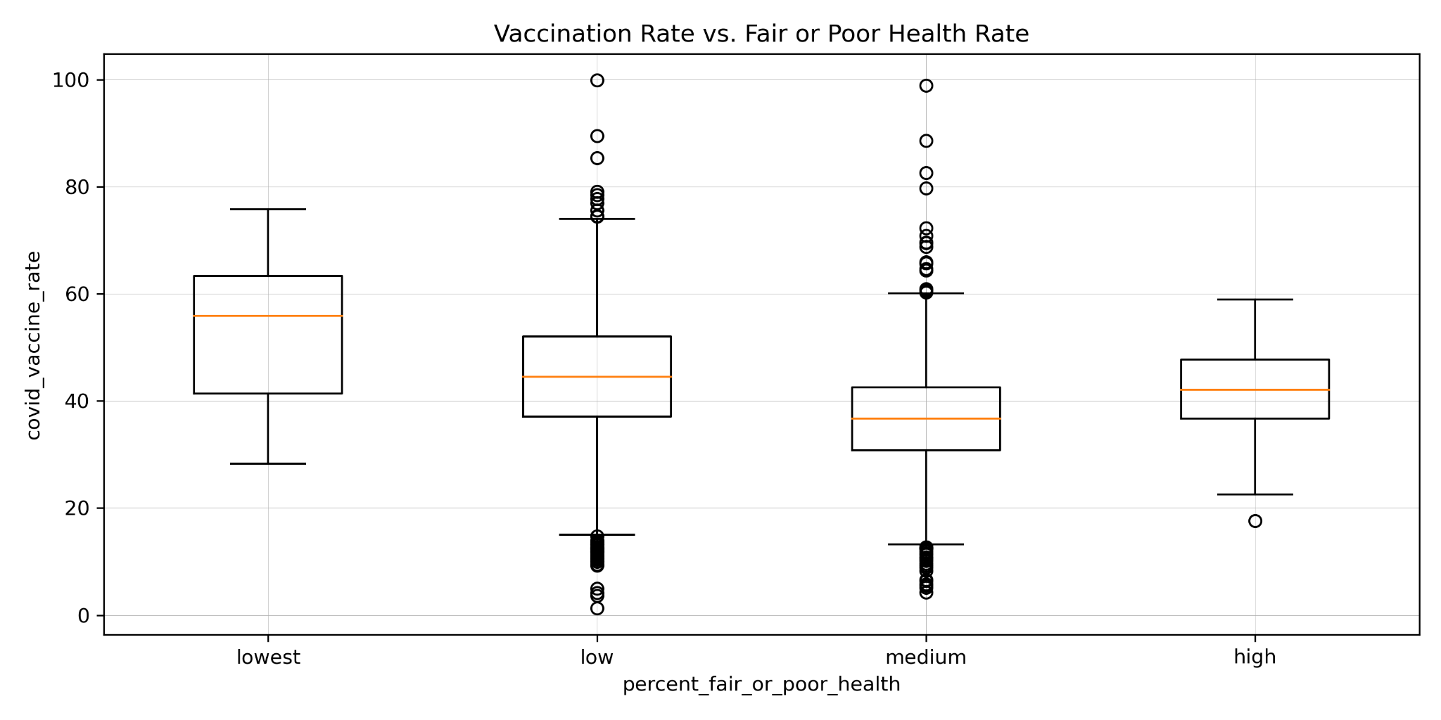
Factor: Vaccination Rate and Percent Fair or Poor Health
The Linear Regression suggested a low negative correlation between SVI and Vaccination Rates
ANOVA Test: Null hypothesis- Vaccination rates from counties with different Fair or Poor Health rate levels have the same means.
The statement is rejected with p-value <0.05, indicating statistically significant difference among groups by fair or poor health rate categories.
The R-squared is: 0.097
F_onewayResult (statistic=54.28, p-value=2.0 * 10⁻⁵⁴)

Slide 18
Implications
Area | Factors | Correlation | Hypothesis Test
Vulnerability | SVI | Low | Significant difference
Political Inclination | President Voting | Na | Significant difference
Socio Economics | Per Capita/ Median Household Income | Low | Significant difference
Socio Health | Uninsured %& Fair or Poor Health % | Low | Significant difference
Education | Some College Education | Low | Significant difference
Vaccination is a complicated topic impacted by many different aspects.
Our analysis picked factors in a wide range including area vulnerability, political, socio economy, education, health condition etc and deep dived into a few of them.
There is not a simple or a few factors with strong enough correlation with vaccination that can explain the vaccination rate variety or make a reliable prediction.
ANOVA tests do indicate some factors have statistically significant impact on the varieties.

Slide 19
Further Analysis:
Look at more factors and more datasets
Better visualize the vaccination and differences in factors using the Google Maps
Prediction is possible in the future with further knowledge of multi-factor regression and machine learning. Models can be created to predict vaccination rates among certain populations.
This means more resources can be allocated to those populations that are less likely to have access. Public information campaigns can be created to target those populations that are more likely to be vaccine hesitant.
Difficulties and Lessons Learned:
Difficulties in looking at the categories within the ANOVA test and comparing them
Difficulties in GitHub merging coordination. We learned that having the same starting point with how to organize and add files within repo would have created a better environment for future merges and less merging conflicts.
Notes:
Under Further analysis I might add: look at the time dimension, some of the data may have changed significantly since Sept 30 due to mandates and return to work/school for many individuals affecting vaccination rates.

Slide 20
Questions?

